Slide 1

SAI VIDYA INSTITUTE OF TECHNOLOGY
Department of Computer Science and Engineering
Rajanukunte, Bengaluru - 560064
Technical Seminar on
HYPERLOOP TECHNOLOGY
FIFTH MODE OF TRANSPORTATION
Under the guidance of
Prof. Ashwini S S
Asst. Prof, CSE
By
DEEPAK JAISWAL - 1VA18CS010

Slide 2
Presentation Outline
Introduction
Related Work
Architecture/other diagrams
Advantages
Disadvantages
Applications
Conclusion
References
Dept. of CSE, SVIT 2

Slide 3
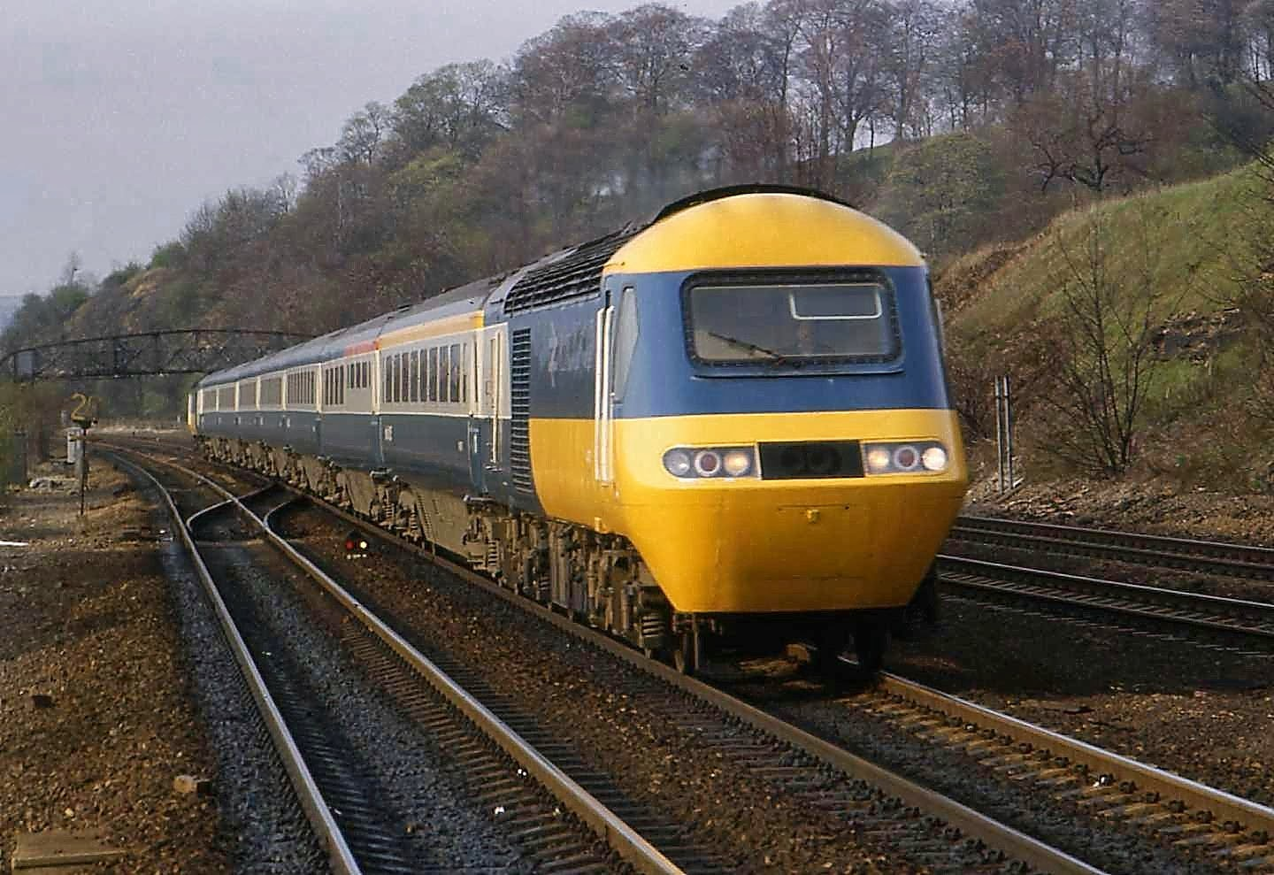

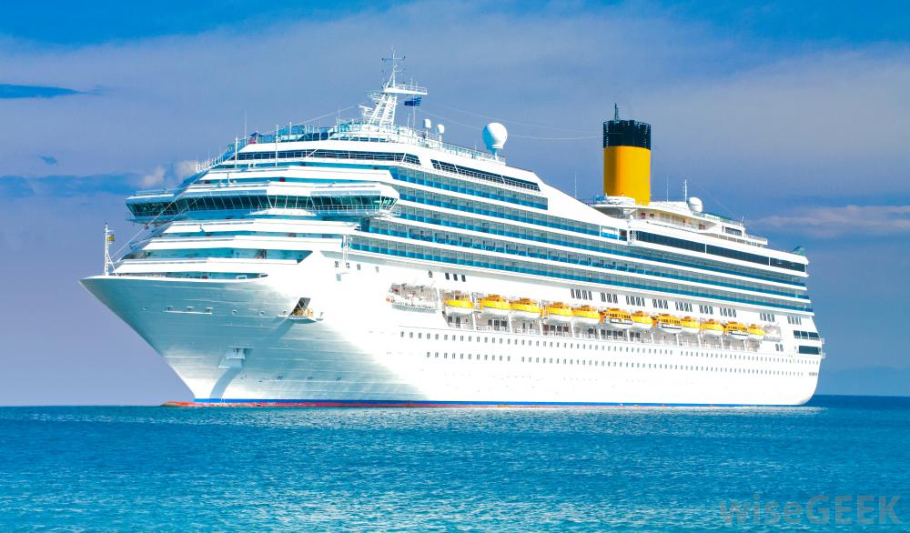

Introduction
CURRENT MODES OF TRANSPORTATION
Dept. of CSE, SVIT 3

Slide 4
Introduction
Hyperloop concept is a completely new mode of fastest transportation.
Hyperloop is firstly proposed by Elon musk and a team of engineer from Tesla Motors and the Space Exploration Technologies Corporation in 2013.
The concept of hyperloop includes travelling people from one place to another place in a capsule which is propelling at a very high speed.
Dept. of CSE, SVIT 4

Slide 5
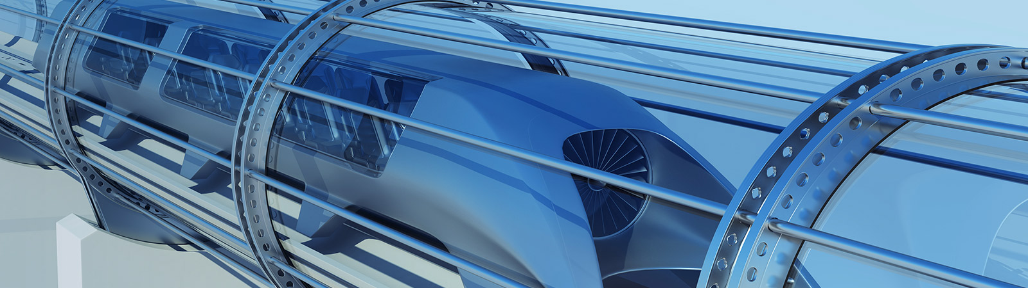
Introduction
Basically hyperloop is magnetically levitated train which runs inside a long tube or pipe.
Dept. of CSE, SVIT 5

Slide 6
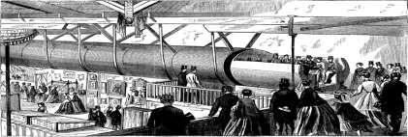
Related work
Hyperloop concept was invented and designed in 1812 by the British Mechanical Engineer George Wenger.
Concepts for high-speed trains in vacuum tubes can be traced back by Robert H. and proposed high-speed passenger-carrying pod traveling through evacuated tubes.
Later, The concept of Hyperloop is developed and redesigned by the billionaire Elon Musk in 2013.
Dept. of CSE, SVIT 6

Slide 7
Architecture
Hyperloop is based on a principle of magnetic levitation.
The principle of magnetic levitation is that a vehicle can be suspended and propelled on a guidance track made with magnets.
The vehicle on top of the track may be propelled with the help of a linear induction motor.
Dept. of CSE, SVIT 7

Slide 8
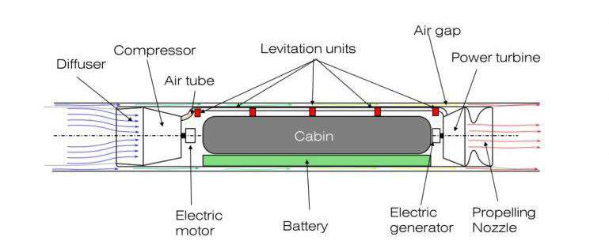
Architecture
Dept. of CSE, SVIT 8

Slide 9
Advantages of HyperLoop
It saves the travelling time.
Low cost than flights and high speed trains.
Highest speed than all transportation methods.
Immune to weather.
Sustainable self powering.
Pollution free.
Dept. of CSE, SVIT 9

Slide 10
Disadvantages of HyperLoop
Less movable space for passenger.
Punctured tunnel could cause shockwaves.
Complex repair procedure.
Number of passengers are less than some other transportations.
High speed might cause dizziness in some passenger.
Dept. of CSE, SVIT 10

Slide 11
Applications of HyperLoop
Passengers Transportation
Emergency healthcare use
Transportation of goods
Dept. of CSE, SVIT 11

Slide 12
Conclusion
The futuristic transportation system is yet to become an everyday reality.
As Hyperloop is a new concept, it would require some future work for development of this project.
Hyperloop is the first new form of public transportation in over 100 years. Hyperloop Technology will fundamentally change the way we travel, work and live.
Dept. of CSE, SVIT 12

Slide 13
References
Musk, Elon (August 12, 2013). “Hyperloop” Tesla. Retrieved August 13, 2013 (https://www.tesla.com/sites/default/files/blog_images/hyperloop-alpha)
Prospects and Challenges of the Hyperloop Transportation System: A Systematic Technology Review -IEEE Paper (https://ieeexplore.ieee.org/document/9350309)
Dept. of CSE, SVIT

Slide 14
THANK YOU
Dept. of CSE, SVIT 14

